Slide 1
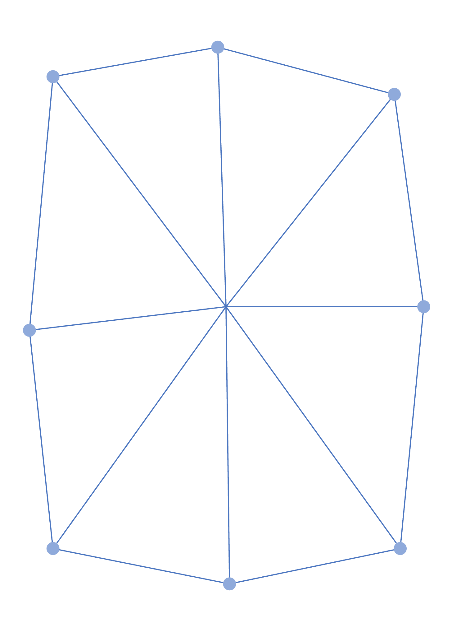
RASID
Citi × NPCI DRUNIX Hackathon 2026 · Stage 3 idea pitch
e-Invoice token
FUNDED
₹8,00,000
Buyer accepted · due in 60 days
IRP signature
✓ Verified
Hindi for “receipt”
Duplicate check
✓ Unique
Fraud-proof invoice finance for India’s MSMEs, built on DRUNIX and paid in hours, not months.
AI risk score
Low · 0.08
Paid via IMPS
in 3 h 12 min
key 9f3a…c41e = SHA-256(IRN)
Team
Registration ID
Primary theme
ARD
STU5011
Real Asset Tokenization
One verified token per invoice, shared by every lender on the network.
Notes:
RASID, Hindi for “receipt”, turns every GST e-invoice into one verified token on a shared DRUNIX ledger. The card on the right is what a lender sees: the invoice’s IRP signature is verified, it is unique across the network, it has an AI risk score, and it was paid out over IMPS within hours. MSMEs get paid in hours instead of months, and lenders can finance invoices without fear of fakes or double financing. Primary theme: real asset tokenization; it also touches real-time payments, financial inclusion and AI fraud detection.

Slide 2
MSMEs wait months to be paid, and lenders can’t safely fund the wait
₹10.7 lakh cr
Who carries the cost
Group
What happens today
What it costs them
owed to MSMEs in delayed payments¹
MSME suppliers
Paid in 60–120 days, no collateral to borrow against
Informal credit at 18–30% a year
60–120 days
Banks and NBFCs
Can’t see what other lenders have financed
Fraud losses, slow manual checks
typical wait to be paid, despite the 45-day legal limit²
Large buyers
Separate supplier-finance scheme with each bank
Duplicate onboarding, 43B(h) exposure
₹20–25 lakh cr
TReDS platforms
Duplicate checks stay inside one platform
Lenders hesitate to bid
estimated formal MSME credit gap³
Sources: ¹ GAME report on delayed payments (2022). ² MSMED Act s.15; Income Tax Act s.43B(h). ³ IFC and SIDBI estimates.
RASID · Team ARD · Citi × NPCI DRUNIX Hackathon 2026
2
Notes:
MSMEs are owed about ₹10.7 lakh crore in delayed payments and typically wait 60 to 120 days, even though the law says 45. The formal credit gap is ₹20–25 lakh crore, so many borrow informally at 18–30%. The cost falls on everyone: suppliers pay high rates, lenders take fraud losses, buyers run duplicate programmes, and TReDS platforms struggle to attract bids.

Slide 3
The root cause: every lender checks only its own books
Bank A
Four gaps in today’s system
Finances ₹8 lakh
1. Fragmented registries
Checks its own books only
TReDS platforms, bank portals and NBFCs check duplicates only internally.
GST invoice
₹8 lakh
2. One-time checks
owed by a large buyer
Bank B
An invoice is verified at onboarding; nobody tracks it after that.
Finances ₹8 lakh
Checks its own books only
3. Rules miss patterns
Total lent
Circular trading and slightly altered duplicates pass static rules.
₹24 lakh
against one ₹8 lakh invoice
NBFC
4. Manual settlement
Finances ₹8 lakh
Payment references are matched to invoices and split by hand.
Checks its own books only
RASID · Team ARD · Citi × NPCI DRUNIX Hackathon 2026
3
Notes:
Each bank, NBFC and TReDS platform keeps its own books, so the same ₹8 lakh invoice can be financed three times for ₹24 lakh and nobody notices. Four gaps cause this: registries are fragmented, invoices are checked once and then forgotten, static rules miss fraud patterns, and settlement is reconciled by hand. Lenders respond with collateral and high rates.

Slide 4
RASID gives every invoice one verified, tradable record on DRUNIX
1
2
3
4
Verify
Register once
Finance privately
Settle automatically
Checks the IRP-signed QR inside chaincode.
One token per invoice, across all lenders.
Sealed bids; the MSME takes the best rate.
Paid in hours; repaid and split on the due date.
JWT verified against IRP keys; no oracle.
Key = SHA-256(IRN); MVCC stops races.
Bids go through KeyDB; only hashes on-chain.
Payment UTRs confirm each state change.
What changes for each user
User
Today
With RASID
MSME
Waits 60–120 days; borrows at 18–30%
Paid within hours at buyer-risk rates
Lender
Blind to other lenders’ exposure
Network-wide duplicate check and AI score
Buyer
Separate scheme with each bank
One acceptance works with every lender
NPCI
No shared rail for receivables
Neutral network for tokenized invoices
RASID · Team ARD · Citi × NPCI DRUNIX Hackathon 2026
4
Notes:
RASID is a consortium network on DRUNIX shared by NPCI, banks, NBFCs and TReDS platforms. Four things happen to every invoice: chaincode verifies the IRP signature, the invoice is registered once network-wide, lenders bid privately, and settlement is confirmed by real payment UTRs. The table shows what changes for each user.

Slide 5

One invoice, from upload to repayment, in five steps
Step 1
Step 2
Step 3
Step 4
Step 5
Upload
Accept
Bid
Get paid
Repay
MSME
Buyer
Lenders
MSME
Buyer
Photo, voice or e-invoice file, in any Indian language
Confirms amount and due date in one click
Sealed bids during a fixed bid window
Best bid wins; money arrives by IMPS or UPI
e-NACH debit on the due date; lenders paid pro rata
RegisterInvoice
AcceptInvoice
SubmitBid
ConfirmFunding
ConfirmRepayment
REGISTERED · minutes
ACCEPTED · same day
LISTED · bid window
FUNDED · within hours
CLOSED · due date
Time from delivery to cash
Today
60–120 days
With RASID
Hours after the buyer accepts
RASID · Team ARD · Citi × NPCI DRUNIX Hackathon 2026
5
Notes:
Five steps, three users. Each step is one chaincode call, shown in blue, and moves the token to the state underneath. The MSME uploads in any Indian language, the buyer accepts in one click, lenders bid privately, the MSME is paid by IMPS or UPI within hours, and on the due date the buyer’s e-NACH mandate repays and lenders are paid pro rata. Today the same cash takes 60 to 120 days.

Slide 6
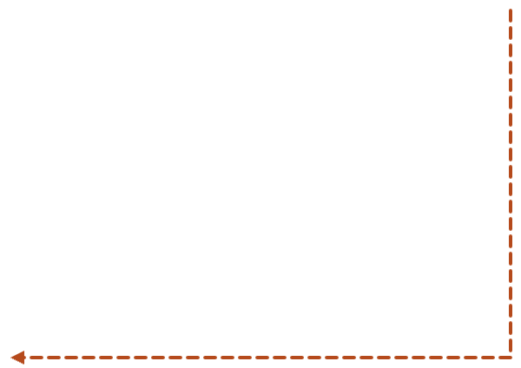
Each invoice token follows one path, enforced in chaincode
REGISTERED
ACCEPTED
LISTED
FUNDING_PENDING
MSME uploads
Buyer signs
Open for sealed bids
Bid awarded
Each arrow is one endorsed DRUNIX transaction that only the right role can send.
CLOSED
REPAID
FUNDED
Lenders paid out
Repayment UTR posted
Payout UTR posted
Solid: normal path. Dashed: exception path.
FUNDED needs a real payout UTR, so the ledger never runs ahead of the money.
DEFAULTED
OVERDUE
Recovery starts
Past the due date
RASID · Team ARD · Citi × NPCI DRUNIX Hackathon 2026
6
Notes:
The InvoiceRegistry contract enforces one path for every token. It is registered by the MSME, accepted by the buyer, listed for bids, and moves to FUNDING_PENDING when a bid is awarded. It becomes FUNDED only after the bank posts the payout UTR, so the ledger and the money never drift apart. After repayment, Settlement pays every holder and closes the token. Late tokens move to OVERDUE, then either REPAID or DEFAULTED.

Slide 7
Users, RASID services and payment rails all meet on DRUNIX
MSME app & WhatsApp
Bank & NBFC portals
TReDS platforms
Buyer ERP portal
Channels
RASID services
API gateway & SDKs
AI risk engine
Settlement adapters
Vernacular assistant
External rails
GST IRP e-invoices
UPI · IMPS · e-NACH
DRUNIX network, operated with NPCI
NEFT · RTGS
RASID chaincode (Go)
Lite peers
Stateless validation
Committing peers
Account Aggregator
DRUNIX network
Raft ordering (NPCI)
YugabyteDB state
KeyDB private data
Falcon on Kubernetes
RASID · Team ARD · Citi × NPCI DRUNIX Hackathon 2026
7
Notes:
Users reach RASID through the MSME app or WhatsApp, bank and NBFC portals, TReDS platforms and buyers’ ERPs. RASID’s own services are the API gateway, the AI risk engine, settlement adapters and a vernacular assistant. Everything that must be trusted lives on DRUNIX: our Go chaincode, lite and committing peers, stateless validation, Raft ordering by NPCI, YugabyteDB for state and KeyDB for private data, deployed with Falcon. Money and identity come from existing rails.

Slide 8
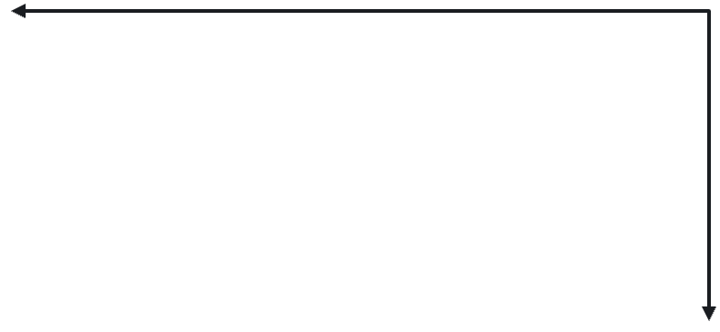
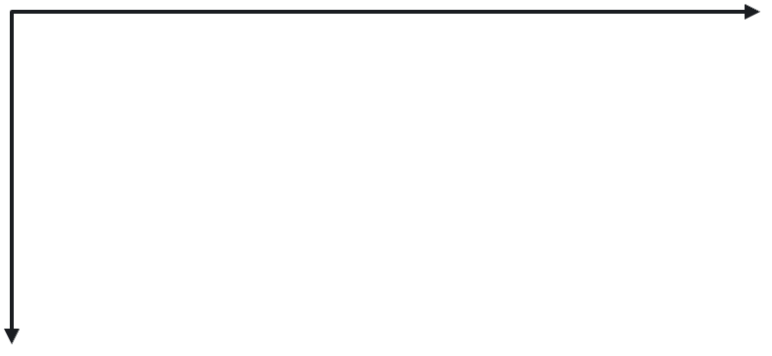
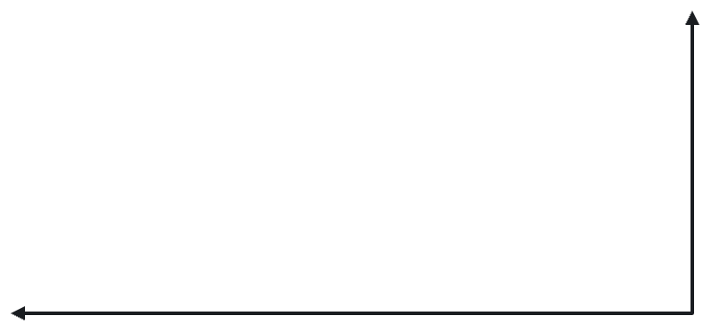
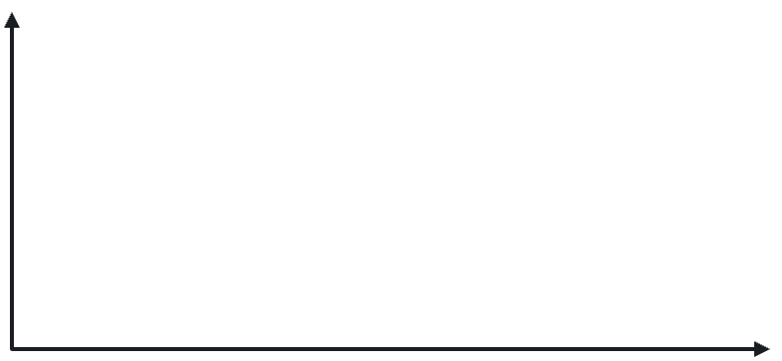
Every lender runs its own peers; NPCI orders and co-endorses
Anchor bank
Partner bank
Buys pools of receivables
Co-lends on large invoices
lite peers + committer
lite peers + committer
One shared registry
Endorsement policy
Every organisation holds the same ledger, so a duplicate invoice is visible to all of them at once.
The originating organisation and NPCI must both sign every state change. Bid data stays in private collections.
NPCI
Network operator
Raft ordering
NBFC
TReDS platform
Originates MSME invoices
Lists invoices for bids
lite peers + committer
lite peers + committer
RASID · Team ARD · Citi × NPCI DRUNIX Hackathon 2026
8
Notes:
Every member runs its own peers: horizontally scaled lite peers for endorsement plus a committing peer. NPCI operates Raft ordering and must co-sign every state change with the originating organisation, so no single lender can rewrite the registry. All members see the same invoice registry, while bid rates and personal data stay in private collections. An anchor bank such as Citi could buy diversified pools of accepted receivables originated by NBFCs.

Slide 9
One invoice end to end: nine steps across DRUNIX and NPCI rails
MSME
Buyer
RASID chaincode
Lender bank
NPCI rails
1 · Register invoice + IRP-signed QR
2 · Buyer accepts
3 · Sealed bid
4 · Award + event
5 · Pay out
6 · Funds reach the MSME within hours
7 · UTR → FUNDED
8 · e-NACH repayment UTR → REPAID
9 · Payout → CLOSED
Dark arrows are DRUNIX transactions. Orange arrows are money moving on NPCI rails.
RASID · Team ARD · Citi × NPCI DRUNIX Hackathon 2026
9
Notes:
Follow one invoice. 1: the MSME registers it; chaincode verifies the IRP signature and rejects duplicates. 2: the buyer signs acceptance. 3: lenders send sealed bids through the KeyDB transient store. 4: chaincode awards the best bid and emits a FundingRequested event. 5 and 6: the winning bank pays the MSME over IMPS, UPI or RTGS within hours. 7: the bank posts the UTR, and only then is the token FUNDED. 8: on the due date the buyer’s e-NACH debit arrives and its UTR marks the token REPAID. 9: chaincode splits the payout among token holders and closes it.

Slide 10
Three checks stop forged, duplicate and risky invoices before listing
Check 1 · chaincode
Check 2 · ledger
Check 3 · AI layer
Invoice submitted
IRP signature valid?
Already registered?
AI risk score high?
Listed for sealed bids
Yes
No
No
No
Yes
Yes
Rejected
Blocked
Held for review
Forged or altered invoice
Duplicate; all lenders alerted
Buyer co-sign and manual check
RASID · Team ARD · Citi × NPCI DRUNIX Hackathon 2026
10
Notes:
Three gates, in order. Chaincode verifies the IRP signature on the e-invoice QR, so a forged or edited invoice is rejected outright. The shared ledger checks the invoice’s unique key network-wide, and its MVCC check stops two simultaneous registrations, so a duplicate is blocked and every lender is alerted. Finally the AI layer scores the invoice; high-risk ones are held for buyer co-signature and manual review. Only invoices that pass all three are listed for bids.

Slide 11
Four Go chaincode contracts hold all of RASID’s business rules
Contract
Key functions
What it enforces
InvoiceRegistry
RegisterInvoice, AcceptInvoice, MarkOverdue
IRP signature, unique key, right role per step
Marketplace
OpenAuction, SubmitBid, AwardBid
Sealed bids, bid window, best-rate award
ReceivableToken
SplitUnits, TransferUnits, BalanceOf
Units always sum to the invoice amount
Settlement
ConfirmFunding, ConfirmRepayment, Distribute
One UTR per payment, pro-rata payouts
Token record (shared ledger)
Private data (KeyDB and collections)
key = SHA-256(IRN) · state · amount · dueDate
bidRate · bidAmount · bidderOrg
sellerHash · buyerHash · units[] · holders[]
msmeBankAccount · contactDetails
riskScoreHash · modelVersion
aaCashFlowSummary (consented)
fundingUTR · repaymentUTR · auditTrail
Purged after blockToLive, for DPDP compliance
Every contract runs under one endorsement policy: the originating organisation and NPCI must both sign.
RASID · Team ARD · Citi × NPCI DRUNIX Hackathon 2026
11
Notes:
This is the code we will write. Chaincode is DRUNIX’s smart-contract layer, and RASID’s four contracts, in Go, hold every rule. InvoiceRegistry verifies the IRP signature, enforces one token per invoice and controls who can move it to each state. Marketplace runs sealed-bid auctions. ReceivableToken splits an invoice into units that lenders can hold and transfer. Settlement accepts payment UTRs and pays holders pro rata. The shared ledger holds only what every member needs; bid rates, bank details and cash-flow data stay in private collections and are purged on schedule.

Slide 12
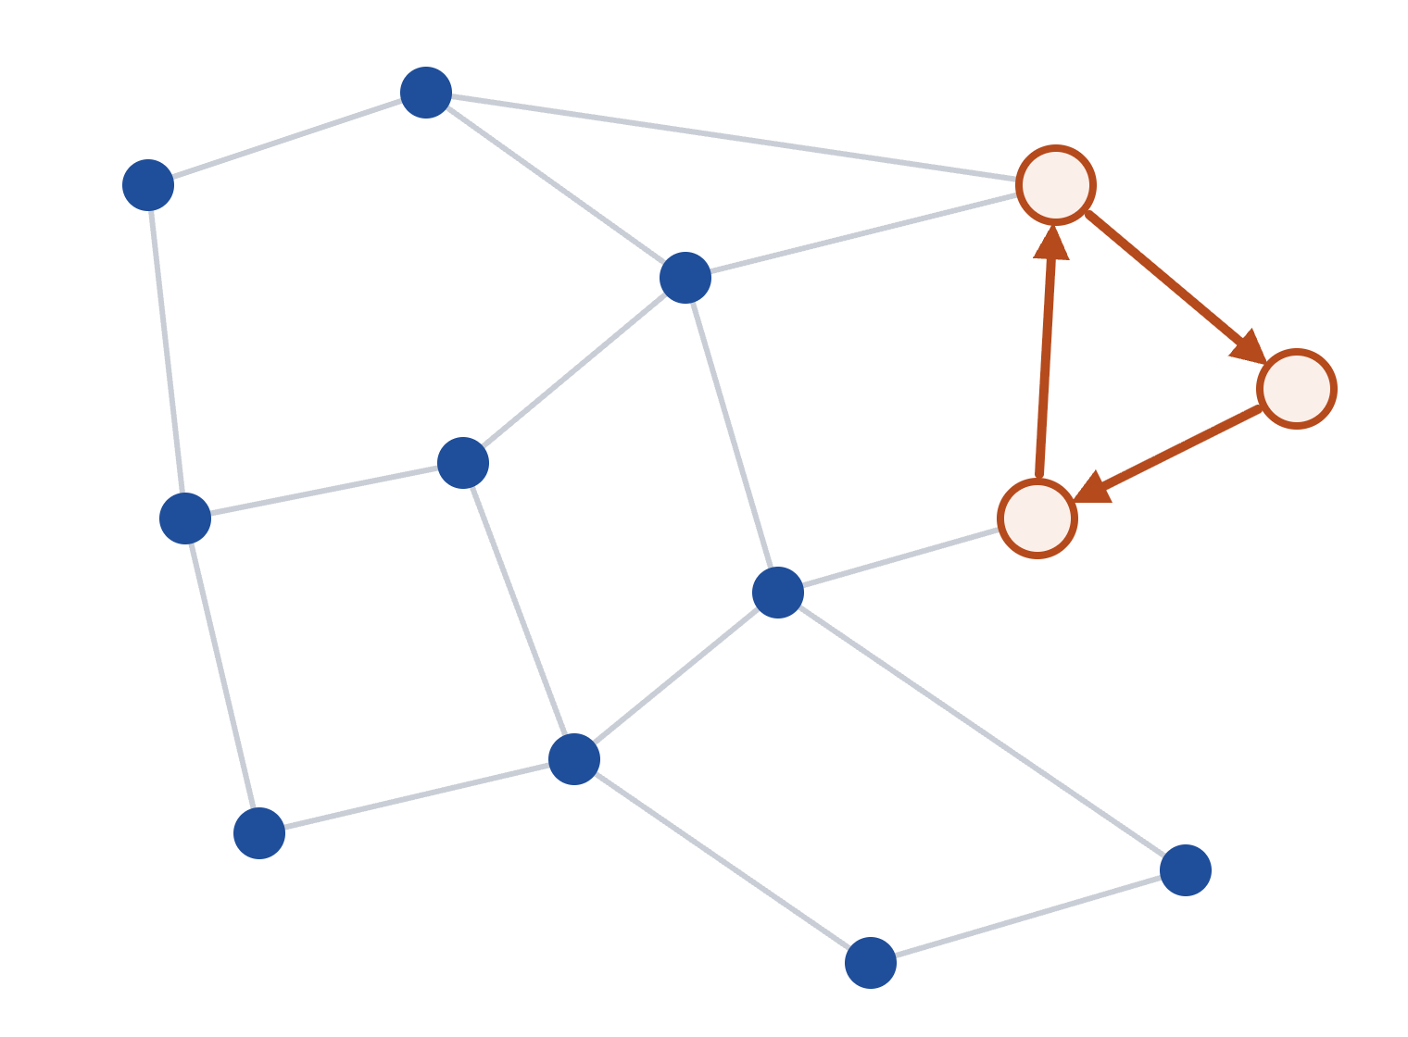
The AI layer sees the whole invoice network, which no single lender can
Circular trading
Graph analysis across all lenders finds loops where related firms bill each other to create fake receivables.
Near-duplicates
Fuzzy matching on amount, date, line items and GSTINs catches re-issued invoices that pass the exact-key check.
Buyer behaviour
Circular loop flagged
On-ledger repayment history and consented Account Aggregator data, so lenders price on the buyer’s risk.
Audit trail
Each score is signed, and its hash and model version are written to the token, so any decision can be audited.
Each dot is a firm; each line is an invoice between two firms.
Prototype: trained on synthetic invoice networks with injected fraud patterns.
RASID · Team ARD · Citi × NPCI DRUNIX Hackathon 2026
12
Notes:
The AI layer runs off-chain but reads the whole network’s invoice graph, which no single lender can see today. It looks for three things: circular trading between related firms, near-duplicate invoices that a strict uniqueness key would miss, and buyer repayment behaviour. Every score is signed by the model service and anchored on the token with the model version, so a regulator can audit any lending decision. For the prototype we train on synthetic invoice networks with known fraud patterns injected.

Slide 13
How RASID uses each DRUNIX building block
DRUNIX element
How RASID uses it
Why it matters
Lite + committing peers
Lite peers scale out; few committers per org
Absorbs month-end spikes cheaply
Stateless validation
Checks signatures and policy in its own service
Stays fast while commits continue
YugabyteDB state
Token state with SQL for exposure reports
LevelDB and CouchDB lack SQL at scale
KeyDB + private data
Bids and bank details stay off the shared ledger
Pricing stays private but provable
Chaincode (Go)
Registry, auction, token and settlement contracts
All business rules in one audited place
Multi-org network
Banks, NBFCs, TReDS and NPCI as separate orgs
No single lender controls the registry
Falcon
Helm charts for each org’s peers on Kubernetes
Repeatable onboarding for new banks
APIs and integrations
UPI, IMPS, e-NACH, GST IRP, AA, Caliper
Real money and identity, no new rails
Planned contributions back to DRUNIX (Apache 2.0)
Caliper benchmark pack
Sealed-bid auction module
Falcon autoscaling profiles
Invoice workloads to test lite-peer scaling
Reusable chaincode built on private data
KEDA rules that add lite peers under load
RASID · Team ARD · Citi × NPCI DRUNIX Hackathon 2026
13
Notes:
We use all eight DRUNIX elements on the form, each for a concrete reason. Lite peers absorb month-end invoice spikes without adding ledger copies. Stateless validation keeps signature checks fast. YugabyteDB gives lenders SQL over the registry for exposure and maturity reports. KeyDB and private data keep bid rates confidential but provable by hash. The Go chaincode is the core logic, the multi-org design means no lender owns the registry, and Falcon makes onboarding a new bank repeatable. We also plan to give three pieces back to DRUNIX: a Caliper benchmark pack, a reusable sealed-bid auction module and autoscaling profiles for Falcon.

Slide 14
At 5% of the delayed-payment pool, RASID saves about ₹790 crore a year
Assumptions (year 3)
Cost of credit for an MSME
Input
Value
Informal
19%
Volume financed
₹50,000 cr, 5% of ₹10.7 lakh cr
With RASID
10%
Average invoice
₹2 lakh, so 25 lakh invoices
Annual savings, ₹ crore
MSME cost of credit
19% informal → 10% with RASID
Interest
740
Average tenor
60 days
Ops saving per invoice
₹200 of manual checks
Operations
50
Financed per MSME
₹1 cr a year, so 50,000 MSMEs
₹50,000 cr × 9% × 60/365 ≈ ₹740 cr
19% is the conservative end of the 18–30% informal range.
25 lakh invoices × ₹200 ≈ ₹50 cr
Savings scale with volume: about ₹316 cr at 2% of the pool and ₹1,580 cr at 10%. Time to cash falls by over 95%.
RASID · Team ARD · Citi × NPCI DRUNIX Hackathon 2026
14
Notes:
Our estimate is bottom-up and every assumption is on the slide. If RASID finances ₹50,000 crore of invoices a year by year 3, about 5% of the delayed-payment pool, moving MSMEs from about 19% informal credit to about 10% buyer-priced discounting saves ₹740 crore a year over a 60-day tenor. Automated verification and reconciliation save another ₹50 crore at ₹200 per invoice. At about ₹1 crore per MSME, that reaches 50,000 MSMEs. The savings scale linearly, so even 2% of the pool is worth over ₹300 crore a year.

Slide 15
RASID adds what today’s invoice-finance options lack
Capability
Typical today
RASID on DRUNIX
Duplicate check
Each lender checks its own books
One registry across all lenders
Invoice authenticity
PDF upload and manual review
IRP signature verified in chaincode
Lender pricing
Bilateral deals or open quotes
Sealed bids, provable by hash
Settlement
Manual reconciliation, days
UTR-confirmed, within hours
Fraud detection
One lender’s data only
AI on the network-wide invoice graph
Neutrality
Platform owned by one party
Run with NPCI; no member controls it
Why it is hard to copy
Network effect
Neutral operator
Open contributions
Each new lender makes double financing harder for every member.
A shared ledger run with NPCI is something no single lender can build.
Our DRUNIX modules keep RASID aligned with the platform’s roadmap.
RASID · Team ARD · Citi × NPCI DRUNIX Hackathon 2026
15
Notes:
Here is how RASID compares with typical invoice finance today. Lenders check duplicates only in their own books, review PDFs by hand, price through bilateral deals and reconcile settlement manually. RASID replaces each of these with something verifiable: a shared registry, chaincode-verified IRP signatures, sealed bids, UTR-confirmed settlement and network-wide fraud detection, all on a ledger no member controls. The moat is the network itself: every lender that joins makes the registry more valuable to the rest, and a neutral ledger run with NPCI is hard for any single player to replicate.

Slide 16
Key risks and how we handle them
Risk
Why it matters
Mitigation
Regulation
Tokenized receivables are new for regulators
Work within TReDS and factoring rules; apply to the RBI regulatory sandbox
Adoption
Value grows only as lenders join
Pilot with one anchor bank and its NBFC partners; buyers accept once for all lenders
Data privacy
GST and bank data are personal data under DPDP
Only hashes on-chain; private collections purged on schedule; consent via Account Aggregator
Throughput
Month-end GST filing creates sharp peaks
Lite peers autoscale; Caliper benchmarks before any pilot
Model risk
A false flag could block an honest MSME
AI only holds invoices for review, never rejects; scores signed and versioned
Buyer default
Lenders lose if the buyer does not pay
e-NACH mandate at acceptance; priced on buyer risk; OVERDUE and DEFAULTED paths on-chain
RASID · Team ARD · Citi × NPCI DRUNIX Hackathon 2026
16
Notes:
We see six main risks. Regulation: tokenized receivables are new, so we start inside existing TReDS and factoring rules and would apply to the RBI regulatory sandbox. Adoption: the network is only valuable with many lenders, so we pilot with one anchor bank and its NBFC partners. Privacy: only hashes go on-chain and personal data is purged on schedule. Throughput: lite peers autoscale and we benchmark with Caliper first. Model risk: the AI can only hold an invoice for review, never reject it. Buyer default: the buyer signs an e-NACH mandate at acceptance, and late or defaulted tokens follow explicit on-chain paths.

Slide 17

Plan: prototype by 22 November, pilot with one bank in 2027
25 Oct
10–22 Nov
22 Nov
4 Dec
2027
Pitch
Build
Ship
Finale
Pilot
Proposal and this deck submitted
Network, contracts, AI model and demo app
Code and README in rasid-drunix
Live demo of one invoice, end to end
One anchor bank and its NBFC partners
Prototype scope
Budget: ₹3,00,000 over 45 days
Three-organisation DRUNIX network deployed with Falcon
Four Go contracts with unit tests
Cloud and Kubernetes · ₹1.2 L
AI model and assistant · ₹50 k
Mock IRP signer and UPI/IMPS sandbox adapters
Integrations · ₹30 k
Security · ₹30 k
Data and design · ₹20 k
Contingency · ₹50 k
Fraud model on synthetic invoice graphs
Caliper benchmark of lite-peer scaling
RASID · Team ARD · Citi × NPCI DRUNIX Hackathon 2026
17
Notes:
We submit this pitch by 25 October and build from 10 to 22 November: a three-organisation DRUNIX network deployed with Falcon, our four Go contracts with tests, mock IRP and UPI/IMPS sandbox adapters, a fraud model trained on synthetic invoice graphs, and a Caliper benchmark. Code and README go into the rasid-drunix repo by 22 November, and at the finale we demo one invoice end to end. The budget is ₹3 lakh over 45 days, mostly cloud infrastructure for the network and benchmarks. After the hackathon, the goal is a pilot with one anchor bank and its NBFC partners.

Slide 18
RASID
The trust layer for India’s MSME receivables, built on DRUNIX.
₹790 cr
50,000
Hours
saved a year at 5% of the pool
MSMEs reached
to cash, not months
github.com/AradhyaSomani/rasid-drunix
Team ARD · Registration ID STU5011
Notes:
To close: RASID is the trust layer India’s MSME receivables are missing. Chaincode makes double financing of a registered invoice impossible, NPCI rails pay MSMEs in hours, and DRUNIX is the core of the system, not an add-on. At just 5% of the delayed-payment pool, that is about ₹790 crore a year saved and 50,000 MSMEs reached. The code will be on GitHub at rasid-drunix. Thank you.

